Slide 1
Marginal Utility
HS201

Slide 2
What is Marginal Utility
In economics, the additional satisfaction or benefit (utility) that a consumer derives from buying an additional unit of a commodity or service is called marginal Utility.

Slide 3
Marginal utility theory
Proposed in the late 19th century by the Marginalist group of economists.
Who used differential calculus to study the impact of small changes in economic quantities,
marginal utility refers to the additional satisfaction a consumer derives from the consumption of one extra unit of a product.
Thus, an individual's demand for a product is determined not by the total utility of it but by its marginal utility.
Therefore, the greater the supply of a product, the smaller its marginal utility.

Slide 4
Law of Diminishing Marginal Utility
The "Law of Diminishing Marginal Utility" states that for any good or service, the marginal utility of that good or service decreases as the quantity of the good increases, ceteris paribus.

Slide 5
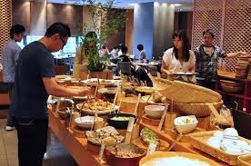
An Example :buffet-style restaurants
This is the premise on which buffet-style restaurants operate.
They entice you with "all you can eat," all the while knowing each additional plate of food provides less utility than the one before.
And despite their enticement, most people will eat only until the utility they derive from additional food is slightly lower than the original.
If you kept eating, you would eventually reach a point at which your eating makes you sick, providing dissatisfaction, or 'dis-utility'.

Slide 6
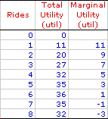
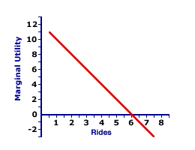
Utility derived
Table:1

Slide 7
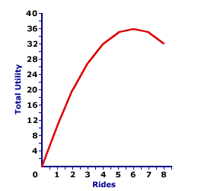
TU Curve
Graph-2

Slide 8
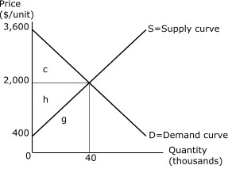
Consumer surplus
Consumer surplus or Consumer's surplus (or in the plural Consumers' surplus) is the difference between the price consumers are willing to pay (or reservation price) and the actual price.
also called social surplus .
It was first developed by Jules Dupuit, French civil engineer and economist, in 1844 and popularized by British economist Alfred Marshall, the concept depended on the assumption that degrees of consumer satisfaction (utility) are measurable.

Slide 9
Importance of CS
Consumer surplus can be used as a measure of the welfare of the consumer.
Welfare can be seen as the well-being of an individual or group.
Any improvement in that well-being can be seen as being a 'good' thing and any reduction being a 'bad' thing.
This can help us to utilise the concept in all sorts of ways to look at the effects of decision making.

